Slide 1
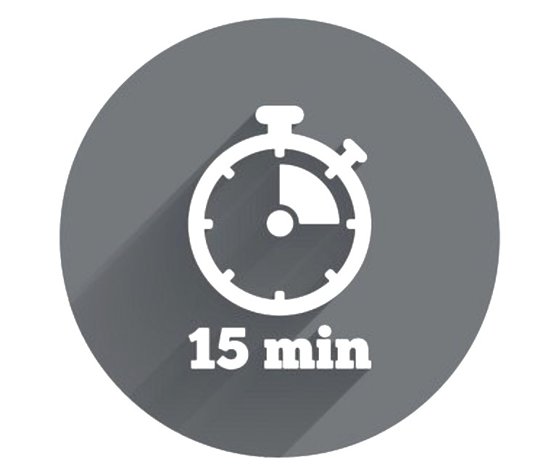

Six Dimensions of Organisational Change
Change comes in all different shapes and sizes. Some changes people transition easily through, while other changes may take longer to adjust to. To help you ‘size up’ a change, and to determine the level of support that others are likely to require of you as a leader, consider the six dimensions of organisational change outlined below. The more significant the change, the more dimensions that are likely to be impacted. Understanding the extent of the impact on each of these dimensions will help you plan your leadership response.
Culture & Values | The core values and embedded cultural norms of the organisation – do they support or challenge the desired change? If they are not aligned the change will not ‘stick’.
Strategy | The defined direction and business plan for the organisation – if the change is not aligned to this it will be a hard ‘sell’.
Structure | The way the organisation/business unit/team is structured – who reports to who and how can impact the implementation and success of the change .
Roles & Responsibilities | The clarity and scope of roles and accountabilities – do these need to be addressed in order to achieve change?
Skills | The actual skills and competencies of employees – do they have the skills needed to embed the change?
Systems & Processes | The procedures and architecture that support the ways of working – are the right systems and processes in place to support the change?
Culture & Values
Structure
Roles & Responsibilities
Strategy
Systems & Processes
Skills
=
+
-

Slide 2
Change Impact Assessment
Drawing on what you know about he change, assess its likely impact on the following six dimensions. Based on the likely impact, what type of support and resources are your team likely to need from you in order to transition successfully through the change?
Dimension of Organisational Change | No Impact | Minimal Impact | Moderate Impact | Significant Impact
Culture & Values The core values ad embedded cultural norms of the organisation – do they support or challenge the desired change? If these are not aligned, the change won’t ‘stick’
Strategy The defined direction and business plan for the organisation – if the change is not aligned to this it will be a hard ‘sell’.
Structure The way the organisation/business unit/team is structured – who reports to who and how can impact the implementation and success of the change.
Roles and Responsibilities The clarity and scope of roles and accountabilities – do these need to be addressed in order to achieve change?
Skills The actual skills and competencies of employees – do they have the skills needed to embed the change?
Systems & Processes The procedures and architecture that support the ways of working – are the right systems and processes in place to support the change?
My leadership response based on the assessed impact of the change:
=
+
-

